Slide 1
Text Vectorization of Medical Notes
Huang Jingfang

Slide 2
Task
The goal of this challenge is to
propose different approaches to
generate vector representations of texts (tokens) and
assess and compare the suitability of the approach
for this dataset.

Slide 3
Approach
Evaluate the two datasets
Apply different ways to tokenize the data and compare the results
Apply different ways to generate vector representations of texts
Assess and compare different vectorization methods

Slide 4
CONTENT
01
Data Visualization
03
Vectorization
Supporting text here.
When you copy & paste, choose "keep text only" option.
Supporting text here.
When you copy & paste, choose "keep text only" option.
02
Text Processing & Tokenization
04
Limitations of the Project
Supporting text here.
When you copy & paste, choose "keep text only" option.
Supporting text here.
When you copy & paste, choose "keep text only" option.

Slide 5
Data Visualization
Supporting text here.
When you copy & paste, choose "keep text only" option.
/01

Slide 6
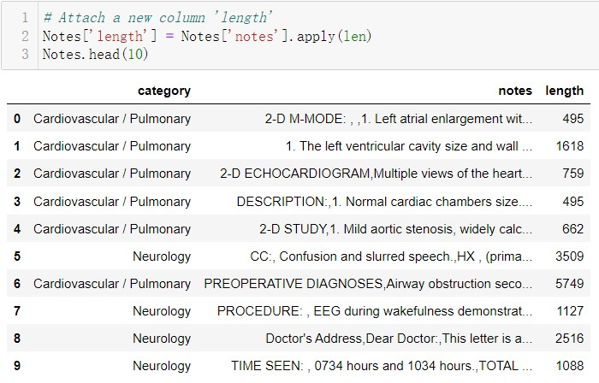
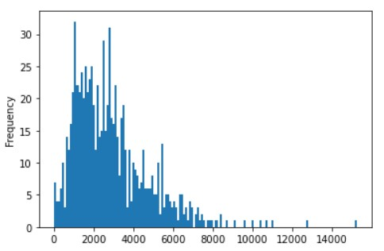
Check the Length of the Documents

Slide 7
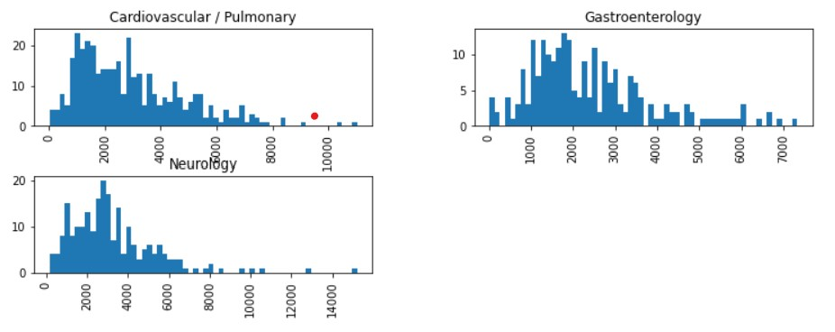

Slide 8
Tokenization
Supporting text here.
When you copy & paste, choose "keep text only" option.
/02

Slide 9
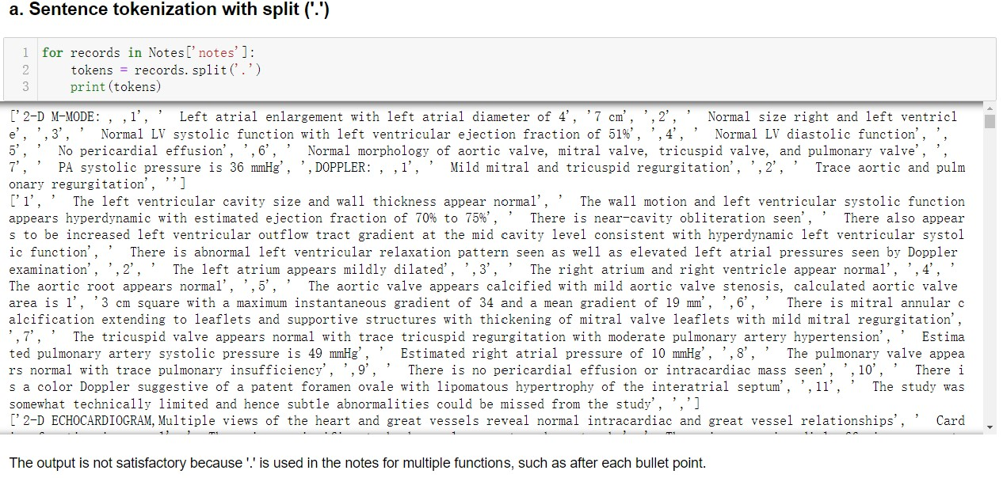

Slide 10
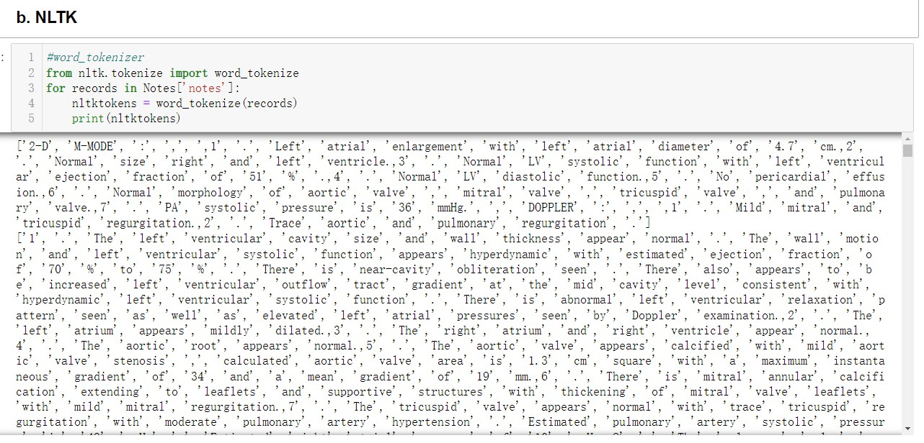
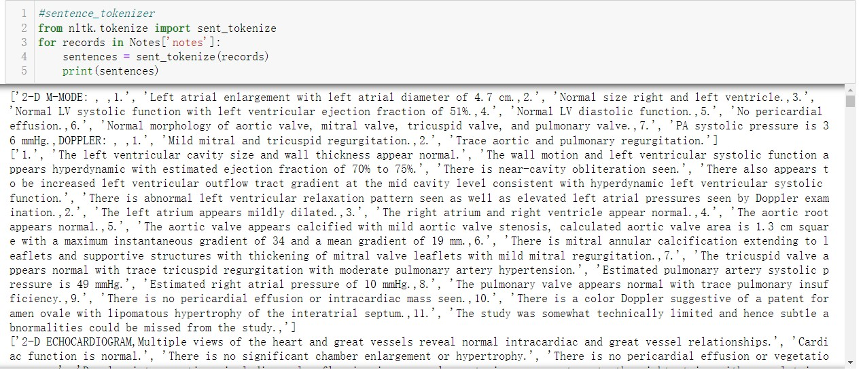

Slide 11
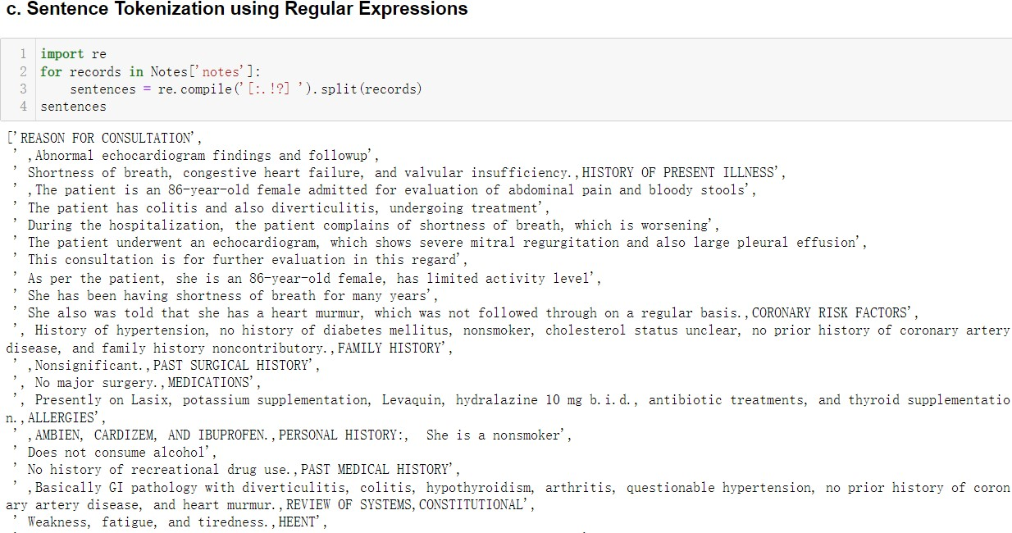
Thought Process 1:
need to treat the different types of the tokens separately, e.g. key words are different from punctuations, stopwords etc.
need to remove distractions like upper/lower-case, punctuations, etc.
need to consider different forms of the same word, e.g. eat, ate, eaten.

Slide 12
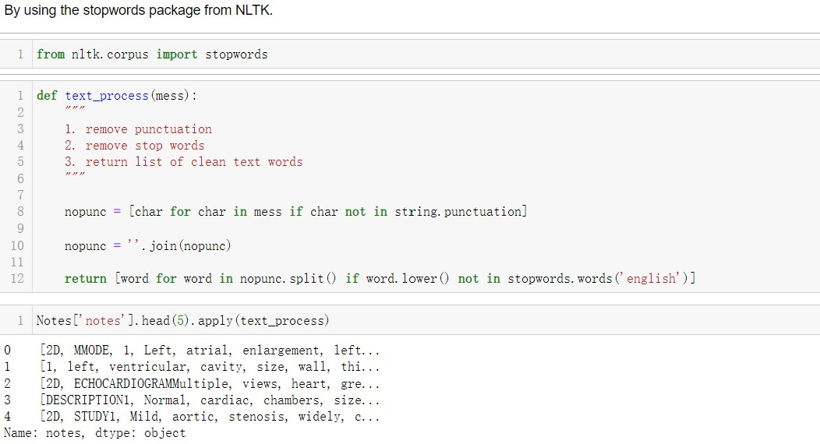
Simple Text Processing

Slide 13
Vectorization
Supporting text here.
When you copy & paste, choose "keep text only" option.
/03

Slide 14
Bag-of-words Model
To vectorize a corpus with a bag-of-words (BOW) approach, I represent every document from the corpus as a vector whose length is equal to the vocabulary of the corpus, and arrive at a vector mapping of the corpus that enables unique representation of every document.
Steps:
use CountVectorizer to convert a collection of text documents to a matrix of token counts
Count number of vocabulary
Use BOW to transform the data
Calculate sparsity

Slide 15
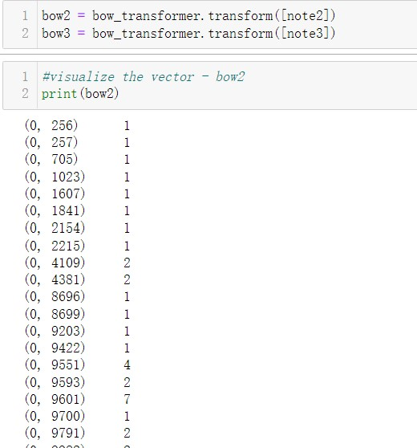
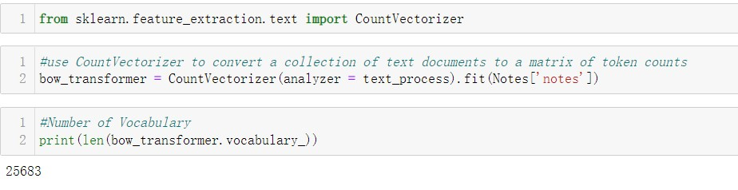

Slide 16
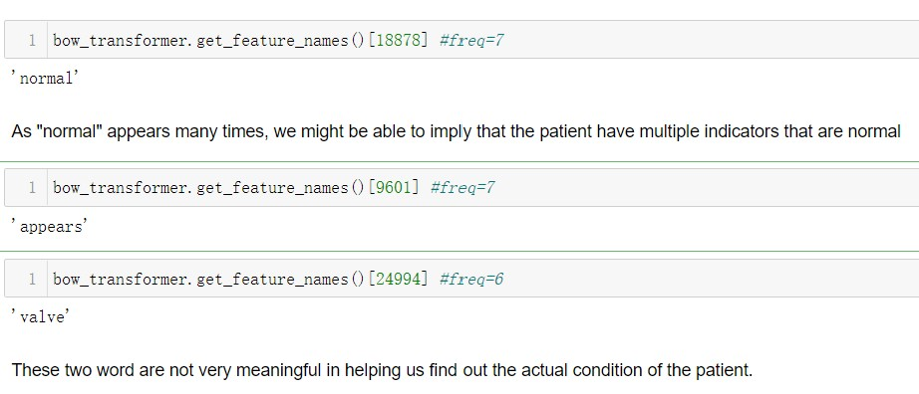
Thought Process 2:

Slide 17
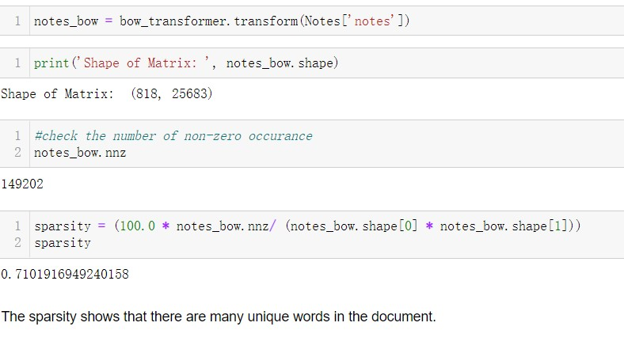

Slide 18
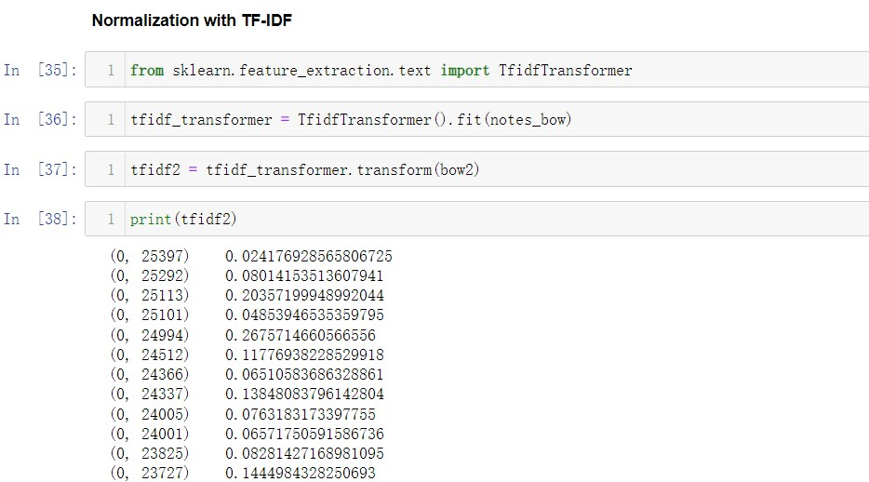
Normalization

Slide 19
Thought Process 3:
Other ways of vectorization?
Frequency
One-hot
TF-IDF
Different ways of implementing them? Available models? Libraries?
Scikit-Learn
Gensim
NLTK

Slide 20
Note
NLTK offers many methods that are especially well-suited to text data, but is a big dependency.
Scikit-Learn was not designed with text in mind, but does offer a robust API and many other conveniences (which we’ll explore later in this chapter) particularly useful in an applied context.
Gensim can serialize dictionaries and references in matrix market format, making it more flexible for multiple platforms. However, unlike Scikit-Learn, Gensim doesn’t do any work on behalf of your documents for tokenization or stemming.
Resources: O'REILLY

Slide 21
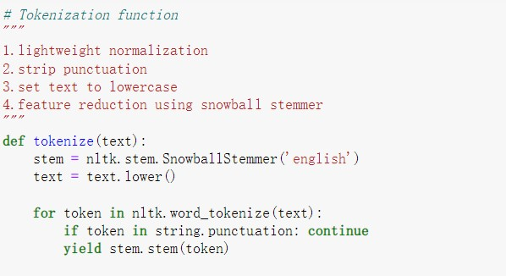
New Tokenization Function

Slide 22
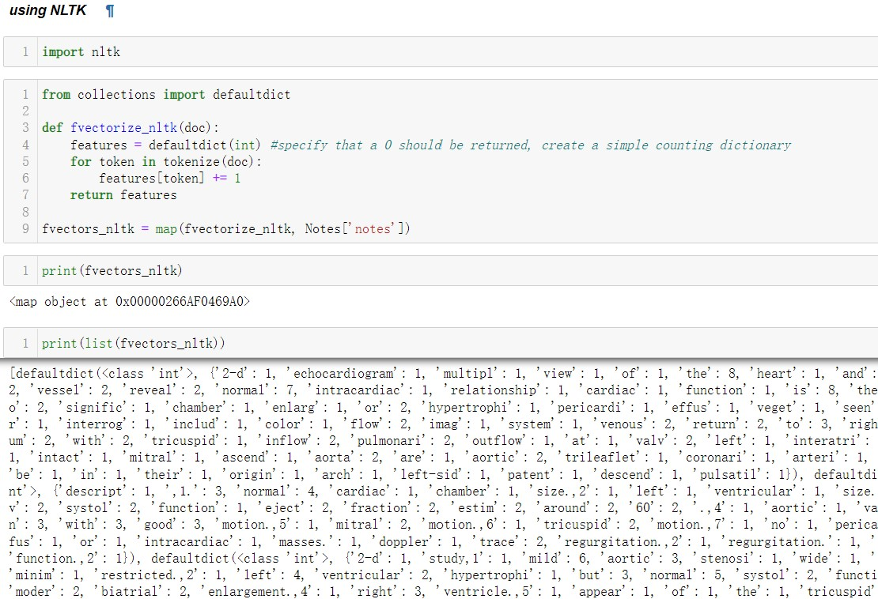
Frequency vectors

Slide 23
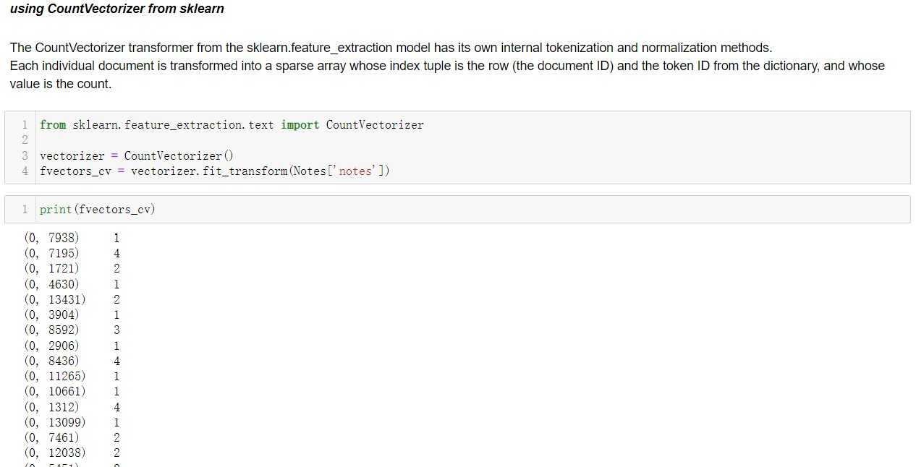
Frequency vectors
* Vectors can become extremely sparse, particularly as vocabularies get larger, which can have a significant impact on the speed and performance of machine learning models.
For very large corpora, it is recommended to use the Scikit-Learn HashingVectorizer, which uses a hashing trick to find the token string name to feature index mapping. This means it uses very low memory and scales to large datasets as it does not need to store the entire vocabulary and it is faster to pickle and fit since there is no state. However, there is no inverse transform (from vector to text), there can be collisions, and there is no inverse document frequency weighting.

Slide 24
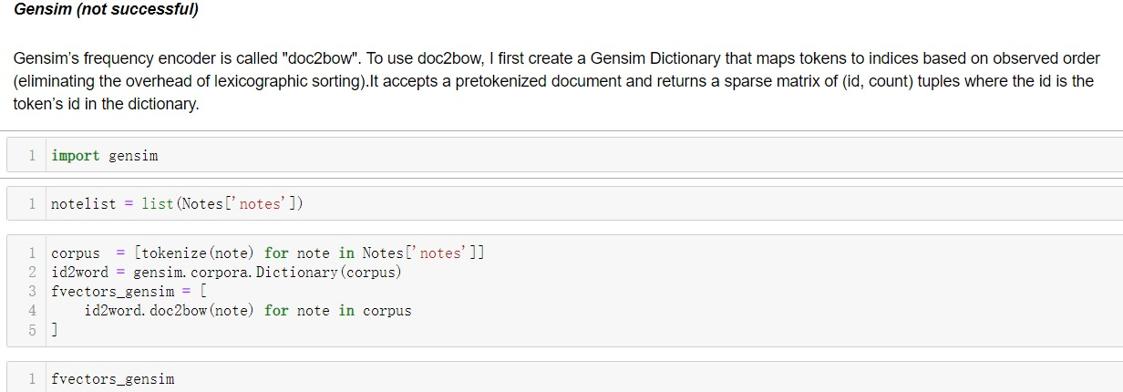
Frequency vectors

Slide 25
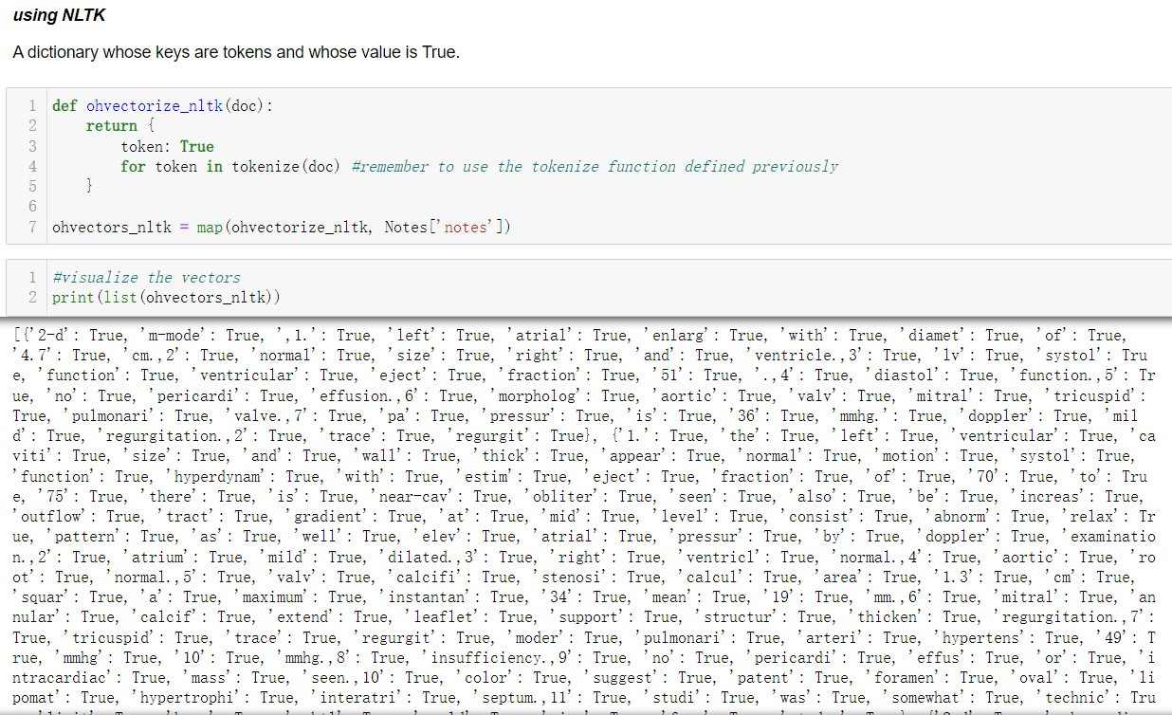
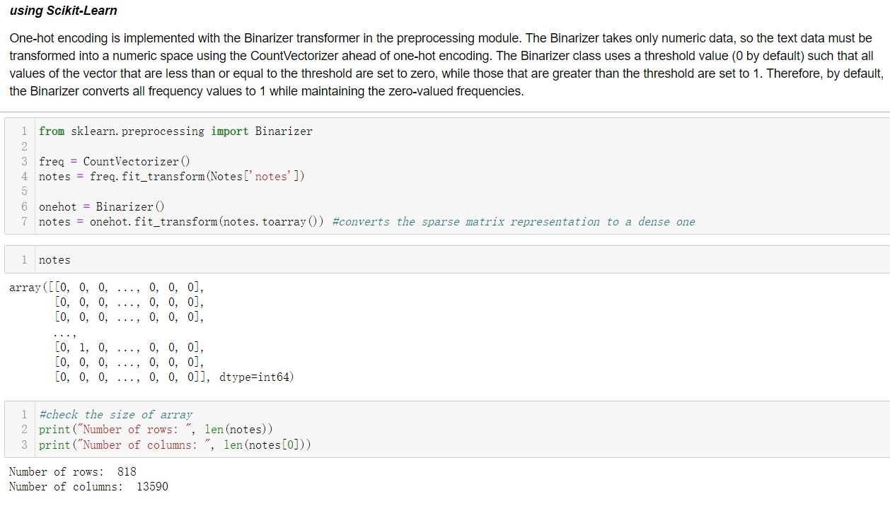
One-Hot Encoding

Slide 26
Thought Process 4:
One-hot encoding represents similarity and difference at the document level, but because all words are rendered equidistant, it is not able to encode per-word similarity.
Moreover, because all words are equally distant, word form becomes incredibly important(solved by stemmer); the tokens “try” and “attempt” will be equally distant from unrelated tokens like “red” or “bicycle”.

Slide 27
TF-IDF
Justification:
The bag-of-words representations does not take into account the context of the corpus. A better approach would be to consider the relative frequency or rareness of tokens in the document against their frequency in other documents.
TF–IDF normalizes the frequency of tokens in a document with respect to the rest of the corpus. This encoding approach accentuates terms that are very relevant to a specific instance.

Slide 28
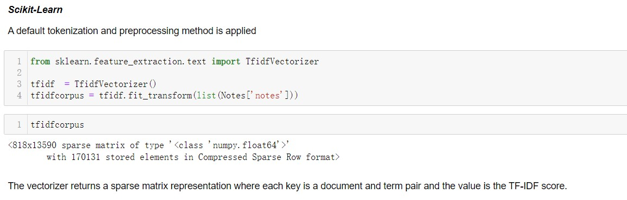
TF-IDF
One benefit of TF–IDF is that it naturally addresses the problem of stopwords as well. This biases the TF–IDF model toward moderately rare words.

Slide 29
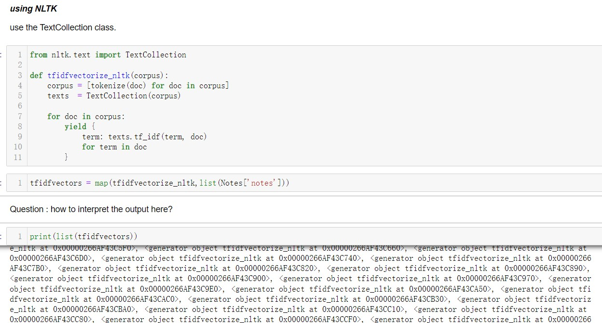
Problem encountered:

Slide 30
Limitations
/04

Slide 31
Thought Process 5:
However, all the vectorization I have learnt and tried so far either simply count the frequency of words or based on the relative frequency in the document.
It will be more meaningful if I apply a model that is able to contextualize word representation. And this is especially needed in this task, as medical notes is very domain specific.
And I think this is also the beauty of NLP! After some research, I found out some possible models that might help me with this task.

Slide 32
Possible Models
Word2Vec,Doc2Vec
BERT
Text here
RoBERTa
ELMo

Slide 33
THANKS

